Slide 1
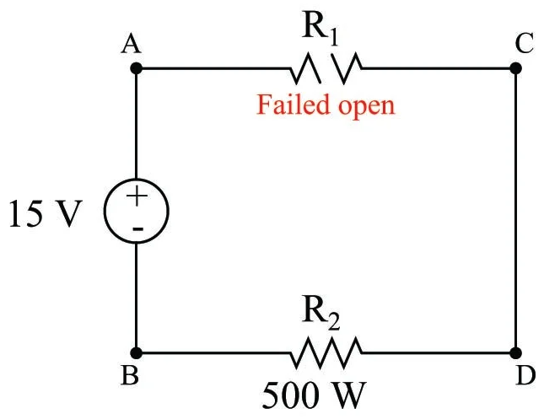
Circuit Breaker

Slide 2

Problem

Slide 3
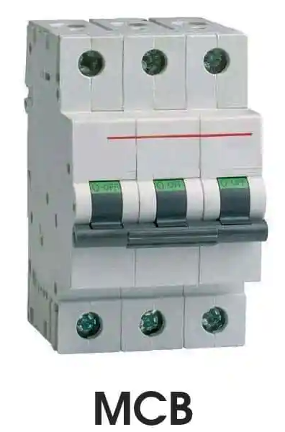
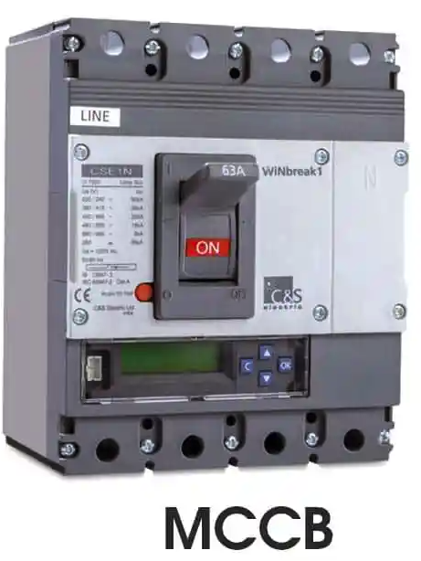

Story
A circuit breaker is an electrical safety device designed to protect electrical circuit from damage caused by overcurrent or short circuit. Its basic function is to interrupt current flow to protect equipment and to prevent the risk of fire. Unlike a fuse, which operates once and then must be replaced, a circuit breaker can be reset (either manually or automatically) to resume normal operation.

Slide 4
Background(Ecommerce)
Rating
service
Database
request
Product service
Product catalog
service
ES
Client
Middleman
response
Circuit Breaker
Payment service

Slide 5
Realization
In a distributed environment, calls to remote resources and services can fail due to transient faults, such as slow network connections, timeouts, or the resources being overcommitted or temporarily unavailable. These faults typically correct themselves after a short period of time, and a robust cloud application should be prepared to handle them by using a strategy such as the Retry pattern.
However, there can also be situations where faults are due to unanticipated events, and that might take much longer to fix. These faults can range in severity from a partial loss of connectivity to the complete failure of a service. In these situations it might be pointless for an application to continually retry an operation that is unlikely to succeed, and instead the application should quickly accept that the operation has failed and handle this failure accordingly.
Additionally, if a service is very busy, failure in one part of the system might lead to cascading failures. For example, an operation that invokes a service could be configured to implement a timeout, and reply with a failure message if the service fails to respond within this period. However, this strategy could cause many concurrent requests to the same operation to be blocked until the timeout period expires. These blocked requests might hold critical system resources such as memory, threads, database connections, and so on. Consequently, these resources could become exhausted, causing failure of other possibly unrelated parts of the system that need to use the same resources. In these situations, it would be preferable for the operation to fail immediately, and only attempt to invoke the service if it's likely to succeed. Note that setting a shorter timeout might help to resolve this problem, but the timeout shouldn't be so short that the operation fails most of the time, even if the request to the service would eventually succeed.

Slide 6
Retry vs Circuit breaker
The Retry pattern enables an application to retry an operation in the expectation that it'll succeed. The Circuit Breaker pattern prevents an application from performing an operation that is likely to fail. An application can combine these two patterns by using the Retry pattern to invoke an operation through a circuit breaker. However, the retry logic should be sensitive to any exceptions returned by the circuit breaker and abandon retry attempts if the circuit breaker indicates that a fault is not transient.

Slide 7
When to use
Use this pattern:
To prevent an application from trying to invoke a remote service or access a shared resource if this operation is highly likely to fail.
This pattern isn't recommended:
For handling access to local private resources in an application, such as in-memory data structure. In this environment, using a circuit breaker would add overhead to your system.
As a substitute for handling exceptions in the business logic of your applications.

Slide 8
Useful links
https://resilience4j.readme.io/docs/circuitbreaker
https://spring.io/guides/gs/cloud-circuit-breaker/
https://www.baeldung.com/spring-cloud-circuit-breaker
https://docs.spring.io/spring-cloud-circuitbreaker/docs/current/reference/html/spring-cloud-circuitbreaker-resilience4j.html

Slide 9
Alternative Implementations
We've seen how to use the Resilience4j implementation to create one or more circuit breakers with Spring Cloud Circuit Breaker.
However, there are other implementations supported by Spring Cloud Circuit Breaker that we can leverage in our application:
Hystrix
Sentinel
Spring Retry
It's worth mentioning that we can mix and match different circuit breaker implementations in our application. We're not just limited to one library.
The above libraries have more capabilities than we've explored here. However, Spring Cloud Circuit Breaker is an abstraction over only the circuit breaker part. For example, Resilience4j also provides other modules like RateLimiter, Bulkhead, Retry in addition to the CircuitBreaker and TimeLimiter modules used in this article.
https://medium.com/bliblidotcom-techblog/resilience4j-circuit-breaker-implementation-on-spring-boot-9f8d195a49e0

